Slide 1

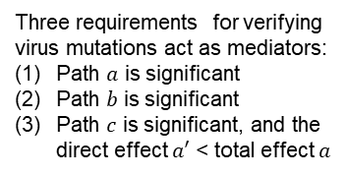


Examine the mediation effect of virus mutations on the relationship between vaccine coverage and CHR
Step 1: Determine the total effect of vaccine coverage on CHR
$a$ (Total effect)
V
H
Basic model
Three requirements for verifying virus mutations act as mediators:
Path $a$ is significant
Path $b$ is significant
Path $c$ is significant, and the direct effect $a′$ < total effect $a$
Step 2: Determine the effect of vaccine coverage on virus mutations (mediators)
V
$$b$$
M
Intermediate model
V
Vaccine coverage
(exposure)
Step 3: Determine the direct and indirect effects of vaccine coverage on CHR
M
$$c$$
(Indirect effect)
M
Virus mutations
(mediators)
V
H
H
CHR
(outcome)
$a′$ (Direct effect)
Mediation model

